Slide 1
E-learning Resource

Slide 2
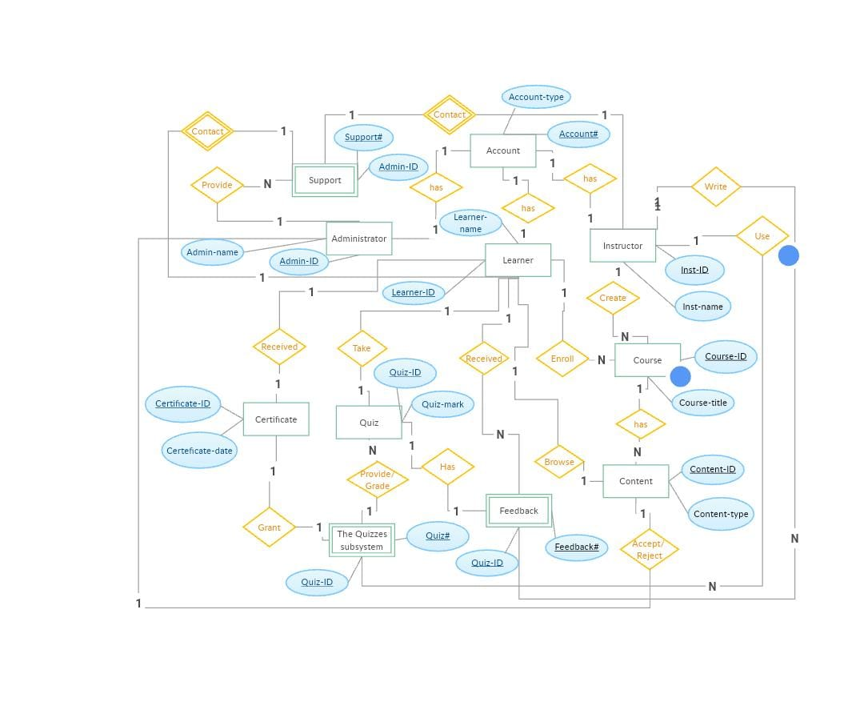
ER diagram

Slide 3
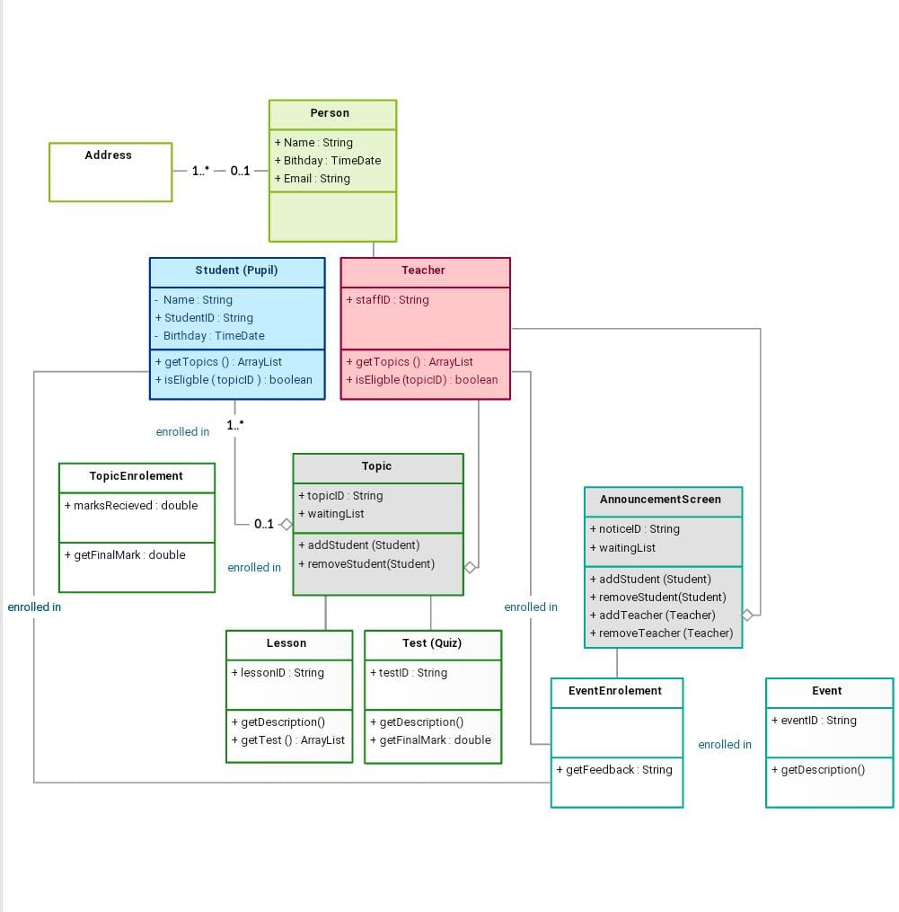
Class diagram

Slide 4
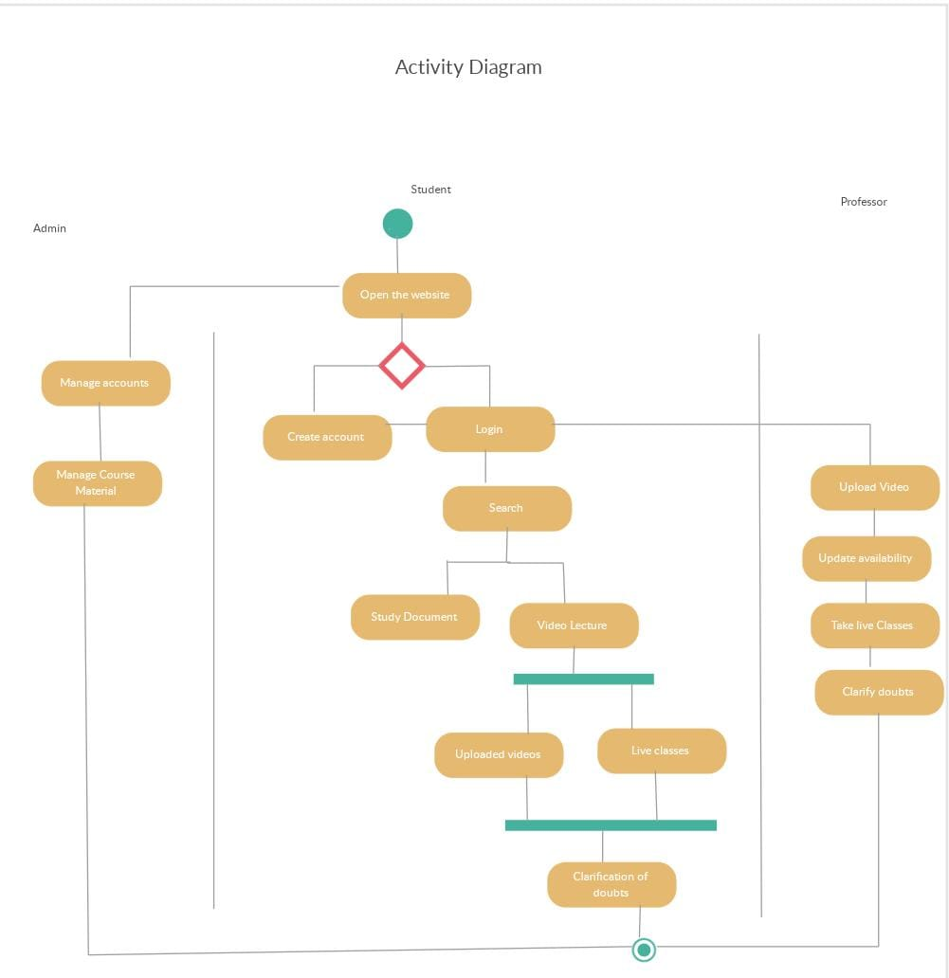
Activity diagram

Slide 5
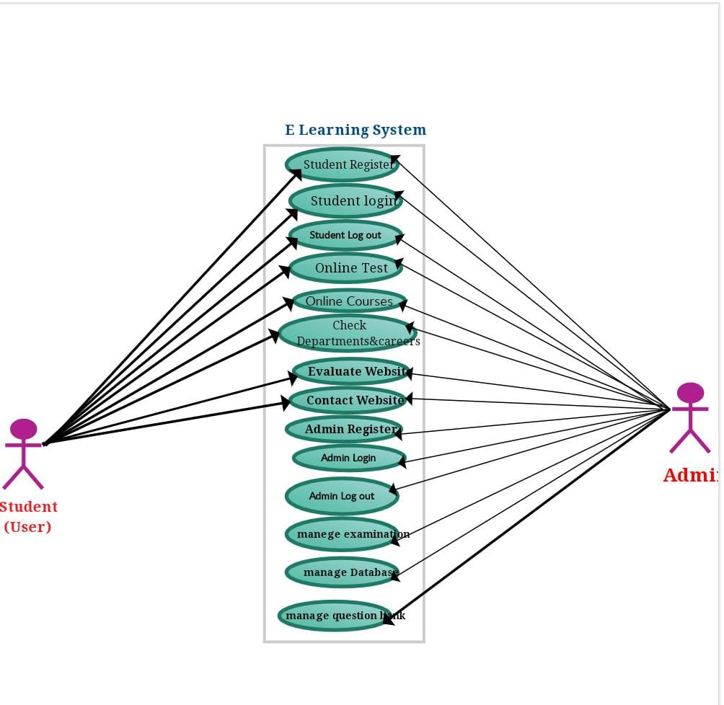
use case diagram

